Slide 1
Introduction to Operating System Course
Lecturer: Trần Tiến Công
Email: congtt@ptit.edu.vn

Slide 2

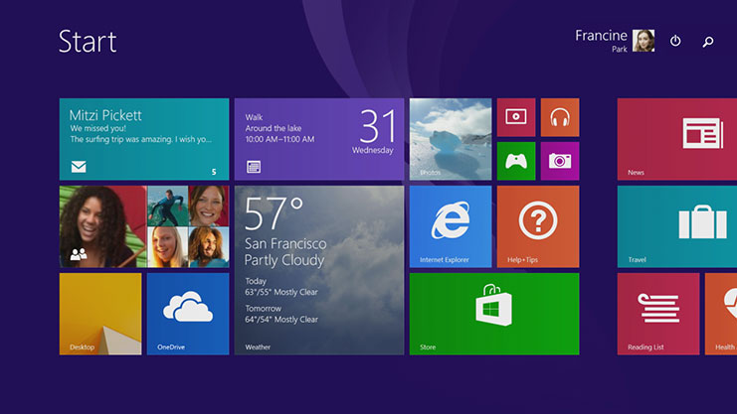
Microsoft Windows
The graphical Microsoft operating system designed for Intel-platform desktop and notebook computers.
Best known, greatest selection of applications available.
Current editions include Windows 7, 8, 8.1, 10, 11.

Slide 3
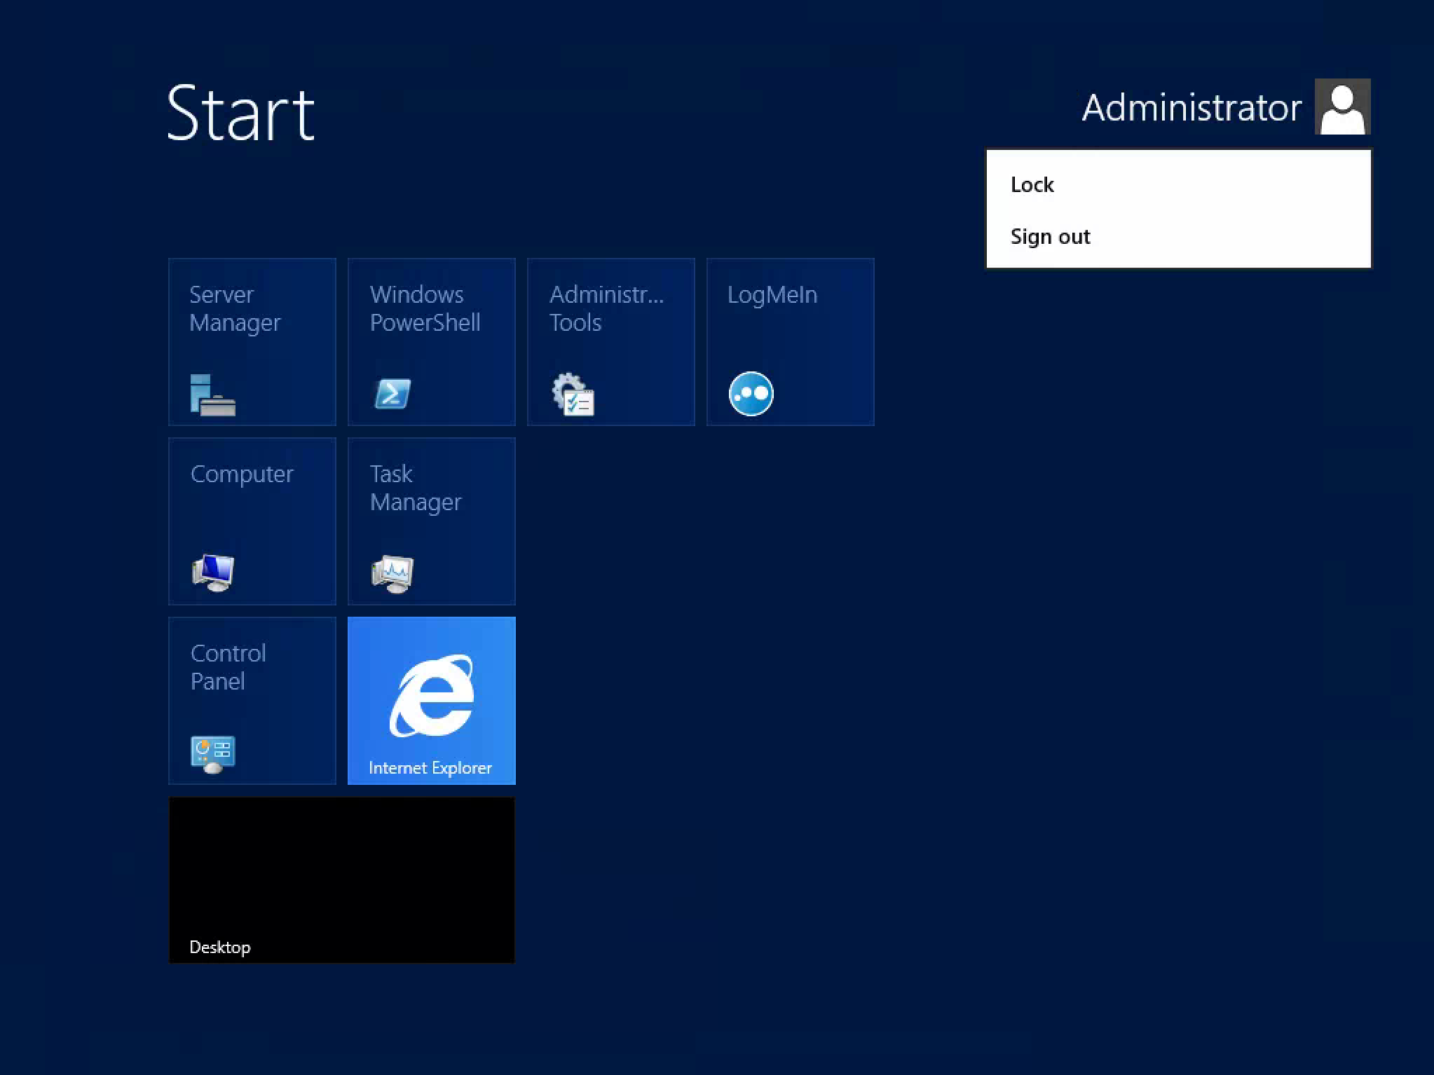
Windows Server

Slide 4
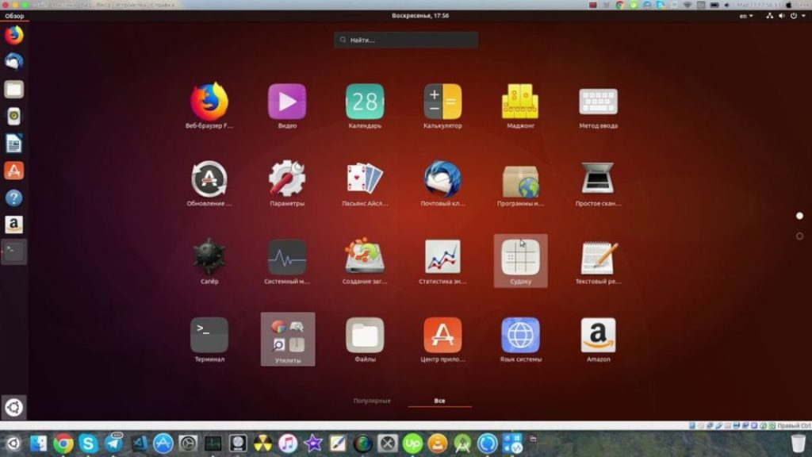
Linux

Slide 5
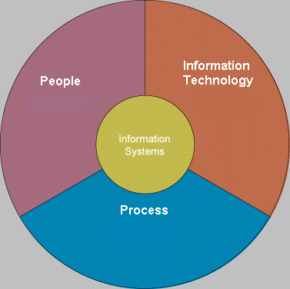
IS Vs IT
An information System (IS) is an arrangement of people, data, processes, Communications, and Information Technology that interact to support and improve day to day operation of an organization as well as support the problem-solving and decision making needs of management & Users.
Information technology (IT) is a contemporary term that describe the combination of Computer Technology (hardware & Software) with telecommunication technology (data, Image and voice network)

Slide 6
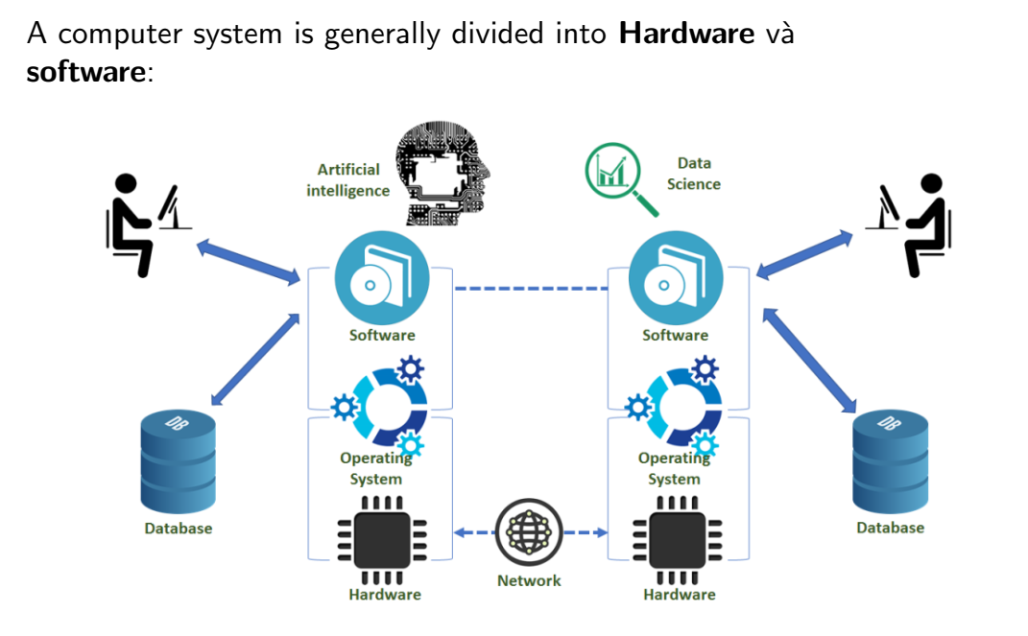
Components of computer systems

Slide 7
What is an Operating System?
Computer System = Hardware + Software
Software = Application Software + System Software(OS)
An Operating System is a system Software that acts as an intermediary/interface between a user of a computer and the computer hardware.
Operating system goals:
Execute user programs and make solving user problems easier
Make the computer system convenient to use
Use the computer hardware in an efficient manner

Slide 8
Why learning about OS?
Understanding how an OS manages hardware, software, and resources is crucial for anyone in IT, as it forms the basis of how computers function.
Knowledge of operating systems helps students understand how software interacts with hardware, including memory management, process scheduling, and file systems.
IT students often need to write programs that efficiently manage multiple tasks. Understanding concepts like processes, threads, and concurrency is essential, and these are deeply rooted in OS principles.
Knowing how an OS allocates resources like CPU time, memory, and I/O devices helps students write optimized and efficient code.
Knowledge of different operating systems (e.g., Windows, Linux, macOS) is vital for developing software that works across platforms.

Slide 9
What do we learn?
Chapter 1: Introduction to operating systems
Chapter 2: File systems
Chapter 3: Process management
Chapter 4: Memory management

Slide 10
How do we learn?
Join google classroom:
tthq4kr

Slide 11
How do we pass?
Attendance: 10%
Practice test: 10%
Multiple choice test at the end of each chapter: 10%
Final exam: 70% - very likely to be Multiple choice test

Slide 12
Questions?

